Slide 1
The Netflix API
The History and Future of the Netflix API
Daniel Jacobson

Slide 2
Netflix Overview
Netflix offers subscriptions to unlimited streaming movies and TV shows for a very low price
  About 700 operational employees, 300 engineers
  More than 25 million subscribers in US and Canada
  Going global, starting with 43 countries in Latin America later this year
  Market capitalization is about $15B
  Responsible for more than 30% of US bandwidth during peak hours, by some accounts

Slide 3
Netflix API Overview
  Launched three years ago
  Services public developers
    About 20K developers
    Almost 13K registered applications
  Services catalog discovery for hundreds of Netflix-branded devices
    Handles more than 1B requests per day
    Peak traffic about 20K requests per second

Slide 4
Original Charter for the Netflix API
  Expose Netflix metadata and services to the public developer community to “let 1,000 flowers bloom”. That community will build rich and exciting new tools and services to improve the value of Netflix to our customers.
Notes:
This is my paraphrase of what the original intent of the Netflix API was.

Slide 5

Netflix
API
Notes:
A visual representation of the original charter

Slide 6












Notes:
The result of the 1,000 flowers model is a wide range of apps and sites built by third-party developers. These are some examples of them.

Slide 7
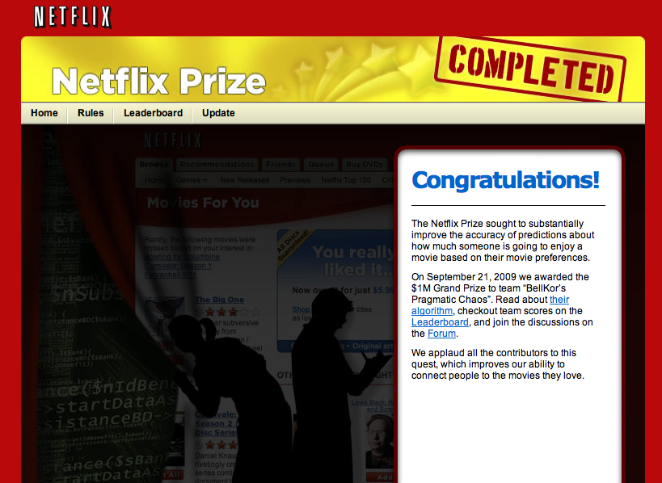
Notes:
Extending our community engagement was the Netflix Prize, which exposed a fixed dataset to registered teams who would work to improve the Netflix recommendations algorithm by 10%. The winning team would receive $1M.
There were several thousand teams that participated in the prize, which lasted about three years.

Slide 8

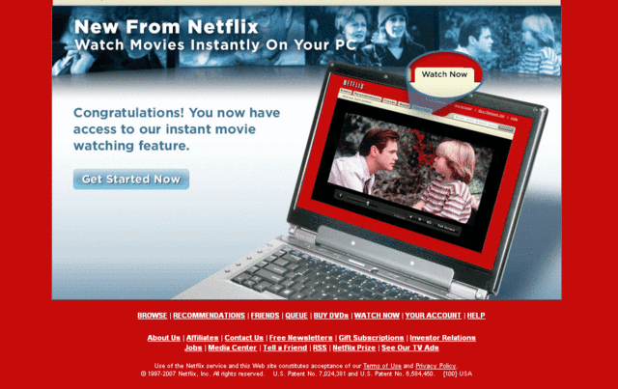
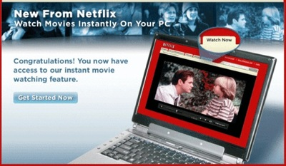
Notes:
Then streaming started taking off for Netflix, first on the desktop and then on devices.

Slide 9
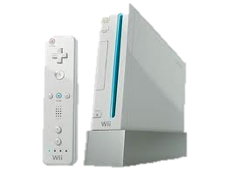




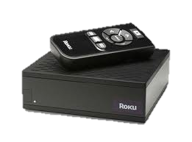

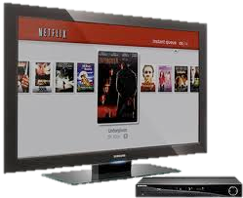

Netflix
API
Notes:
As we broadened the device support, we leveraged the Netflix API to deliver the content. The 1,000 flowers were then sharing the API with internal and external development teams who produce Netflix-branded streaming apps.

Slide 10
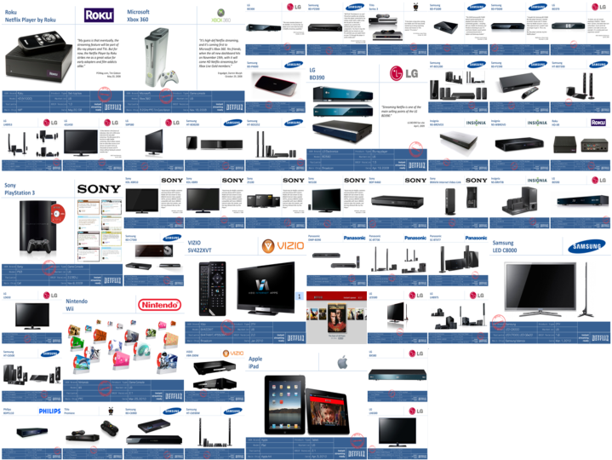
Some of the hundreds of Netflix devices
Notes:
Over time, streaming really took off and now streaming is supported on hundreds of Netflix-ready devices.

Slide 11
Growth of Netflix API Requests
Notes:
The explosion in streaming usage has resulted in tremendous growth in the Netflix API. In the last 12 months alone, the API traffic has gone up 12x, from about 2.5M requests per month to about 31M.

Slide 12
So, why redesign the API if it is so successful?

Slide 13

Morphed Public API to Internal API
Launch of API
Today
… And implemented hundreds of devices
Notes:
As streaming took off, the API continued to morph to support the needs of streaming on hundreds of devices.

Slide 14
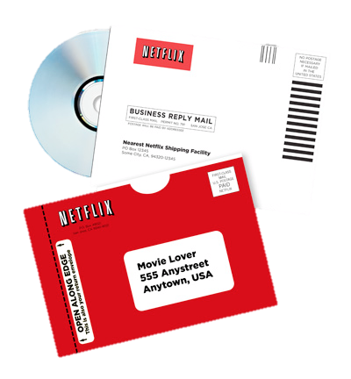
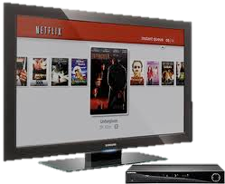
Focusing Business and API on Streaming
Launch of API
Today
Notes:
Moreover, when the API launched, Netflix users were consuming substantially more DVDs. Over time, the focus of the company has shifted more towards streaming.

Slide 15


Migrated from Data Centers to Cloud
Launch of API
Today
Notes:
Meanwhile, major architectural challenges have been undertaken, such as moving the entire streaming operation from data centers to the AWS cloud.

Slide 16
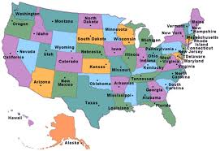

Becoming an International Streaming Company
Launch of API
Today
Notes:
Finally, when the API initially launched, we were a US-only service. Now we are in Canada and have announced expansion to 43 countries in Latin America for later this year.

Slide 17
Many fundamental business changes
No fundamental changes to the API
Notes:
There have been many incremental changes to the API, but none fundamental in the way that match the growth of the business.

Slide 18
Netflix API Requests by Audience
Notes:
So, the 1,000 flowers, who previously accounted for 100% of the total API traffic, now account for < .3% of the total API traffic.

Slide 19
Netflix
API
Notes:
Currently, the API is still based on the design that was targeted towards the public third-party developers with the streaming devices running off the same design.

Slide 20
Future Architecture needs to support key audience first with a trickle down of features to the public audience
Netflix
API
Notes:
What we would like to get to is redesigning the API to be targeted towards the key audience (the Netflix-branded streaming devices) and then trickle down the features to the third-party developers.

Slide 21
The Goal

Slide 22

Over 30 Billion requests per month
(Peaks at about 20,000 requests per second)
Notes:
Metrics like 30+B requests per month sound great, don’t they? The reality is that this number is concerning…

Slide 23
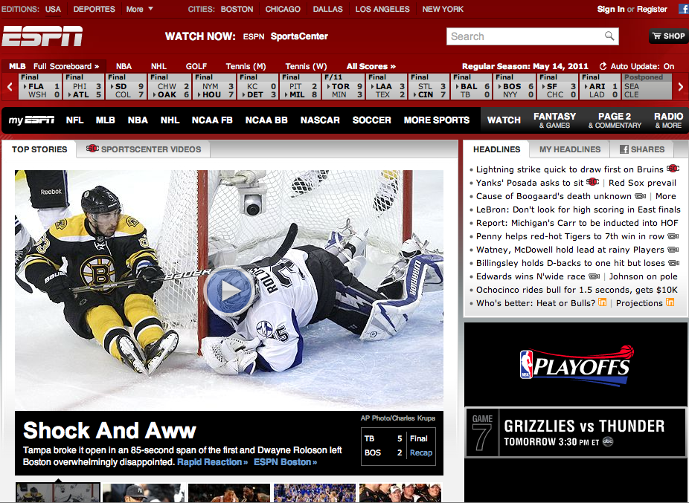
Notes:
In the web world, increasing request numbers mean increasing opportunity of ad impressions, which means increasing opportunity for generating revenue. And when you hit certain thresholds in impressions, CPMs start to rise, which means even more money. That is why some media companies have stories spanning multiple pages, etc.

Slide 24
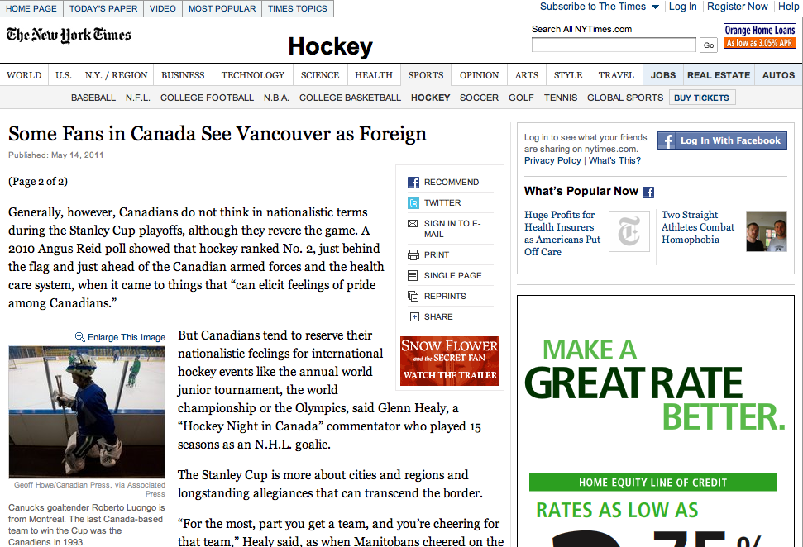
Notes:
And some companies, like The New York Times, create more opportunity for ad impressions by article pagination.

Slide 25

<catalog_titles>
<number_of_results>1140</number_of_results>
<start_index>0</start_index>
<results_per_page>10</results_per_page>
<catalog_title>
<id>http://api.netflix.com/catalog/titles/movies/60021896</id><title short="Star" regular="Star"></title>
<box_art small="http://alien2.netflix.com/us/boxshots/tiny/60021896.jpg"
medium="http://alien2.netflix.com/us/boxshots/small/60021896.jpg"
large="http://alien2.netflix.com/us/boxshots/large/60021896.jpg"></box_art>
<link href="http://api.netflix.com/catalog/titles/movies/60021896/synopsis"
rel="http://schemas.netflix.com/catalog/titles/synopsis" title="synopsis"></link>
<release_year>2001</release_year>
<category scheme="http://api.netflix.com/catalog/titles/mpaa_ratings" label="NR"></category>
<category scheme="http://api.netflix.com/categorieSo, the 1,000 flowers, who previously accounted for 100% of the total API traffic, now…
s/genres" label="Foreign"></category>
<link href="http://api.netflix.com/catalog/titles/movies/60021896/cast"
rel="http://schemas.netflix.com/catalog/people.cast" title="cast"></link>
<link href="http://api.netflix.com/catalog/titles/movies/60021896/screen_formats" rel="http://schemas.netflix.com/catalog/titles/screen_formats" title="screen formats"></link
<link href="http://api.netflix.com/catalog/titles/movies/60021896/languages_and_audio" rel="http://schemas.netflix.com/catalog/titles/languages_and_audio" title="languages and audio"></link>
<average_rating>1.9</average_rating>
<link href="http://api.netflix.com/catalog/titles/movies/60021896/similars" rel="http://schemas.netflix.com/catalog/titles.similars" title="similars"></link>
<link href="http://www.netflix.com/Movie/Star/60021896" rel="alternate" title="webpage"></link>
</catalog_title>
</catalog_titles>
{"catalog_title":
{"id":"http://api.netflix.com/catalog/titles/movies/60034967",
"title":{"title_short":"Rosencrantz and Guildenstern Are Dead",
"regular":"Rosencrantz and Guildenstern Are Dead"},
"maturity_level":60,
"release_year":"1990",
"average_rating":3.7,
"box_art":{"284pix_w":"http://cdn-7.nflximg.com/en_US/boxshots/ghd/60034967.jpg",
"110pix_w":"http://cdn-7.nflximg.com/en_US/boxshots/large/60034967.jpg",
"38pix_w":"http://cdn-7.nflximg.com/en_US/boxshots/tiny/60034967.jpg",
"64pix_w":"http://cdn-7.nflximg.com/en_US/boxshots/small/60034967.jpg",
"150pix_w":"http://cdn-7.nflximg.com/en_US/boxshots/150/60034967.jpg",
"88pix_w":"http://cdn-7.nflximg.com/en_US/boxshots/88/60034967.jpg",
"124pix_w":"http://cdn-7.nflximg.com/en_US/boxshots/124/60034967.jpg"},
"language":"en",
"web_page":"http://www.netflix.com/Movie/Rosencrantz_and_Guildenstern_Are_Dead/60034967",
"tiny_url":"http://movi.es/ApUP9"},
"meta":{
"expand":["@directors","@bonus_materials","@cast","@awards","@short_synopsis","@synopsis","@box_art","@screen_formats","@"links":{"id":"http://api.netflix.com/catalog/titles/movies/60034967",
"languages_and_audio":"http://api.netflix.com/catalog/titles/movies/60034967/languages_and_audio",
"title":"http://api.netflix.com/catalog/titles/movies/60034967/title",
"screen_formats":"http://api.netflix.com/catalog/titles/movies/60034967/screen_formats",
"cast":"http://api.netflix.com/catalog/titles/movies/60034967/cast",
"awards":"http://api.netflix.com/catalog/titles/movies/60034967/awards",
"short_synopsis":"http://api.netflix.com/catalog/titles/movies/60034967/short_synopsis",
"box_art":"http://api.netflix.com/catalog/titles/movies/60034967/box_art",
"synopsis":"http://api.netflix.com/catalog/titles/movies/60034967/synopsis",
"directors":"http://api.netflix.com/catalog/titles/movies/60034967/directors",
"similars":"http://api.netflix.com/catalog/titles/movies/60034967/similars",
"format_availability":"http://api.netflix.com/catalog/titles/movies/60034967/format_availability"}
}}
Notes:
But for systems that yield output that looks like these documents, such as APIs, ad impressions are not part of the game. As a result, the increase in requests don’t translate into more revenue. In fact, they translate into more expenses. That is, to handle more requests requires more servers, more systems-admins, a potentially different application architecture, etc.

Slide 26

Could it have been 5 billion requests per month? Or less?
(Assuming everything else remained the same)
Notes:
We are challenging ourselves to redesign the API to see if those same 30+ billion requests could have been 5 billion or perhaps even less. Through more targeted API designs based on what we have learned through our metrics, we will be able to reduce our API traffic as Netflix’ overall traffic grows. Reduction in traffic results in lower server counts (and costs), fewer demands on systems infrastructure engineers, etc. More importantly, if rendering a single page on a UI can be done in 2 transactions instead of 15, the end user will see tremendous benefits in overall performance of the app.

Slide 27
The Challenge

Slide 28
Some of the many
Netflix-ready
devices
Notes:
So, we are now on hundreds of devices. How do we modify our development approach to make it easier to add new devices? How do we improve the efficiency around device implementation to match the efficiencies that the API provide us?

Slide 29

API
Recommendation Engine
User Info
Movie Metadata
Movie Ratings
Similar Movies
Reviews
etc…

Slide 30
The Problem with This Approach
This device:
Is different than this device:

Slide 31
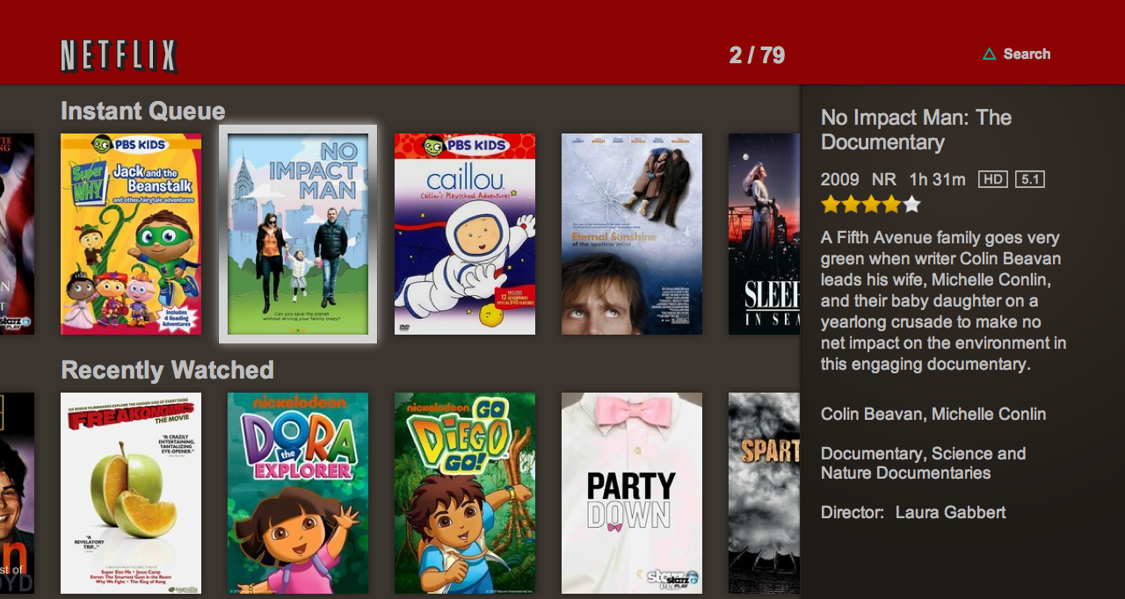
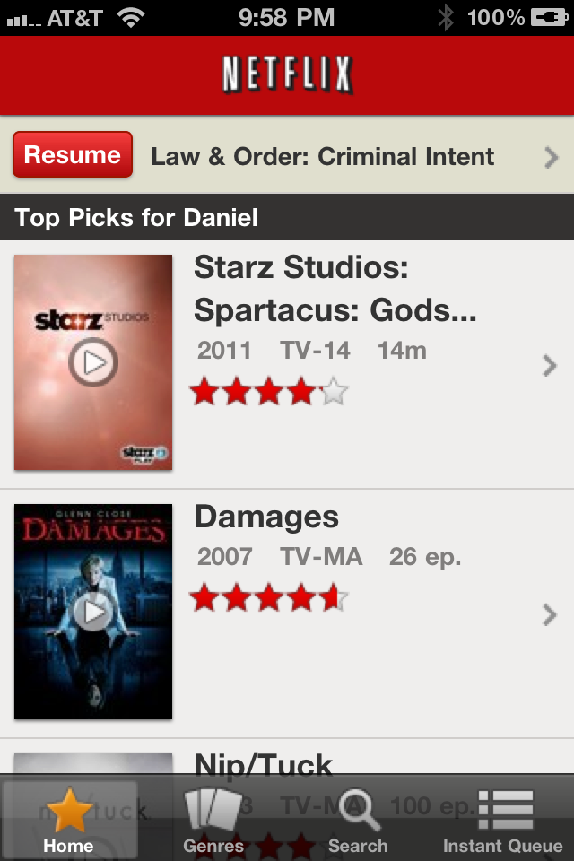
The Problem with This Approach
And this UI:
Is different than this UI:

Slide 32
Some of the many
Netflix-ready
devices
Notes:
So, we are now on hundreds of devices. How do we modify our development approach to make it easier to add new devices? How do we improve the efficiency around device implementation to match the efficiencies that the API provide us?

Slide 33
Products and Features Vary from Device to Device
Aspect Ratios
Connection Speeds
Security Concerns
Screen Real Estate
User Expectations
User Interaction Models
  Touchscreens
  Remote controls
  Game controllers
  Voice commands

Slide 34
Some Unique Requests of API Across User Interfaces
Output Format Expectations
  Proprietary XML markup
  Flattened JSON object model
  Hierarchical JSON object models
Hardware Constraints
  Significant memory constraints
Metadata Delivery Needs
  Different fields required for different UIs
  Some UIs are easier to build/maintain if they stream the bits on delivery

Slide 35
Conclusion:
Most REST APIs are designed to generically accommodate the needs of a large number of clients
but they are optimized for none

Slide 36
New Charter for the Netflix API
  Build and maintain an infinitely scalable data distribution pipeline for getting metadata and services from internal Netflix systems to streaming client apps on all platforms in the format and/or delivery method that is most optimal for each app and platform.

Slide 37
So, What Does This Look Like?

Slide 38
API
Personalization Engine
User Info
Movie Metadata
Movie Ratings
Similar Movies
Reviews
etc…
Notes:
Netflix has an array of internal engineering teams who specialize in discreet problems, such as recommendations, movie metadata, reviews, ratings, etc. That content needs to be delivered to the hundreds of Netflix-branded streaming devices (many of which are developed by internal engineering teams within Netflix). The API is the central pipeline that delivers that material to the devices.
Right now, the API is a generic pipeline that the individual devices all call, basically in the same ways.

Slide 39
API
Personalization Engine
User Info
Movie Metadata
Movie Ratings
Similar Movies
Reviews
etc…
Notes:
We would like to get to a model where the API, in addition to offering the generic pipeline, also offers custom endpoints that the devices can call to replace the high-transaction needs currently found in rendering more complicated screens on the various devices. These custom endpoints will allow the API to do the heavy lifting in preparing the responses needed to render these complicated screens rather than requiring the client apps to handle it through many API calls.

Slide 40
Generates
List of IDs and Returns All Metadata for Each
Wrappers Manipulate Metadata for Each Title Returned
REQUEST WRAPPER
CLIENT APP
REQUEST WRAPPER
REQUEST WRAPPER
HANDLER
Serialized Metadata Object
REQUEST WRAPPER
DEFAULT
RESPONSEWRAPPER
API ENGINE
Contract Data Model
CUSTOM RESPONSEWRAPPER
RESPONSE WRAPPER
HANDLER
DEPENDENCIES
Dependency Management to Populate Metdata Object
CUSTOM RESPONSEWRAPPER
REQUEST
RESPONSE
HANDLER
CUSTOM RESPONSEWRAPPER
DEDICATED
LOCATION ON API
FOR CLIENTS
API SERVERS
CLIENT APPS
Notes:
The model may look something like this, where the solid vertical black line to the right is dividing the clients from the servers:
Client app makes a call across HTTP to a request handler.
The request handler determines if the request is a custom endpoint or a generic one.
If generic, the request gets sent to the API engine.
If customer, the request goes to a request wrapper that knows what this custom endpoint needs. In some cases, it will explode the single request into many so it can retrieve all of the necessary data for the request.
The API engine, in all cases, will make the appropriate calls to the dependencies to get all of the information needed to compile a response.
The dependencies’ output will get pushed to a serialized metadata object that passes the response metadata up the stack to prepare delivery.
The API engine, once brokering all of the metadata, will pass the serialized object to a response wrapper that determines what formatting script is needed to prepare the response.
If the request was to a generic endpoint, the response wrapper handler will pass the serialized object to the default response wrapper where the response will be formatted and delivered.
If the requests was to a custom endpoint, the response wrapper handler will pass the serialized object to the appropriate custom wrapper where the serialized object will be pruned, formatted and delivered in the optimal way for that particular device and UI.

Slide 41
Notes:
As we expand internationally, this degree of flexibility becomes even more important as the variability of devices, Uis, user expectations, country-specific elements, etc. could continue to grow dramatically.

Slide 42
Key Ideas for the API Redesign
Custom endpoints for appropriate screens on appropriate devices
  Brings complexity to the server
  Limits network transactions costs
  Limits byte size on payload
Give power of custom endpoints to device development teams
  Allows them to be more nimble
  Minimizes (or removes?) versioning needs at the formatting level
Maintain native API for generic requests
  Should handle majority of distinct queries, but minority of requests
  Also to be exposed to public developers
Isolate tiers of system and technology based on job
  Formatting tier may be in lighter-weight language (like Scala, Grails, etc.)

Slide 43
Benefits with This Approach
Isolation
  Problems with a formatting script are isolated to that UI
Rapid Development
  UI teams can get a lot of what they want without waiting for API team
  Changes to scripts don’t require full API pipeline deployments
Versioning
  Because the scripts are very targeted, we may not need to version that output

Slide 44
Challenges with This Approach
Increased variability in request profiles
  More testing
  More risk of problems
Maintenance challenges
  Formatter script repository could grow large
  Harder to triage issues
Duplicative work
  UI teams could do redundant work in their scripts

Slide 45

Questions?
Want to help redesign the Netflix API? Please contact me at: Daniel Jacobson djacobson@netflix.com @daniel_jacobson http://www.linkedin.com/in/danieljacobson

